Slide 1

REFLECTIONS ON HARM DUE TO NUCLEAR WEAPONS TESTING
Democratizing science for a healthier environment
Physicists Coalition for Nuclear Threat Reduction webinar
2023-07-31
Arjun Makhijani, Ph.D
www.ieer.org

Slide 2
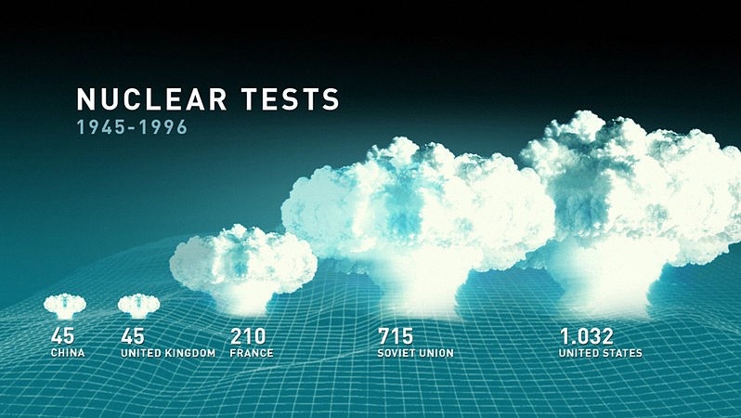
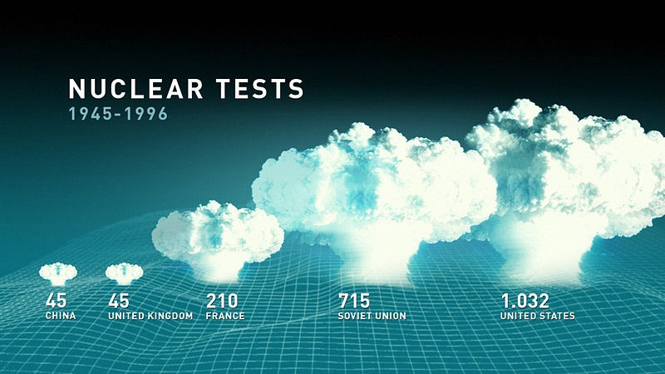
CTBTO test total shown: 2,047. Subsequently: India 3, Pakistan 2, North Korea 3.
Source: The Official CTBTO Photostream, at http://commons.wikimedia.org/wiki/File:Nuclear_Tests_1945-1996_-_Flickr_-
_The_Official_CTBTO_Photostream.jpg

Slide 3
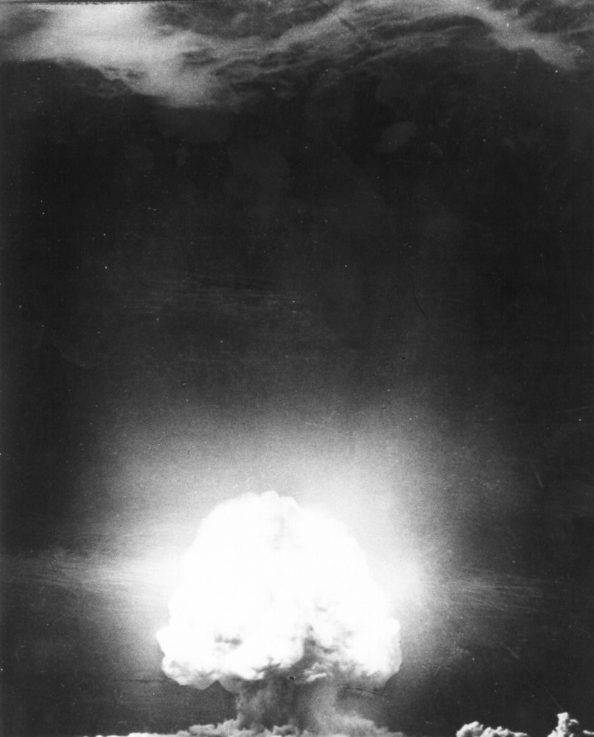
“Trinity” test: tower shot – dust stirred up leading to large “fallout”
Notes:
Source: https://commons.wikimedia.org/wiki/File:Trinity_Test_Mushroom_Cloud_12s.jpg

Slide 4
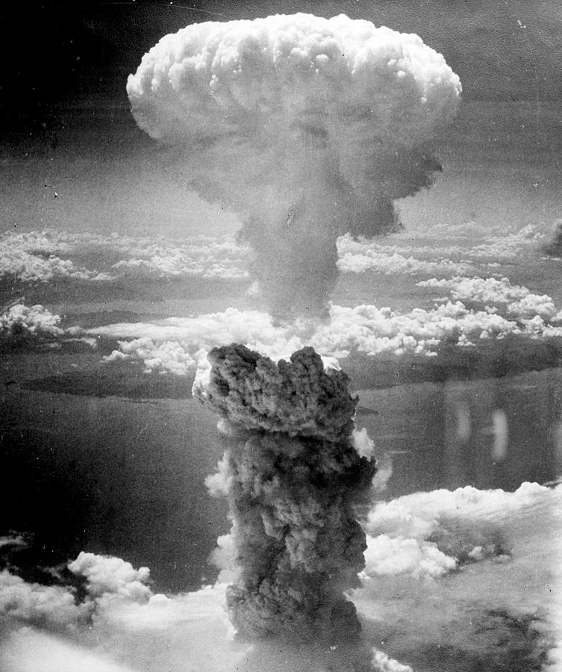
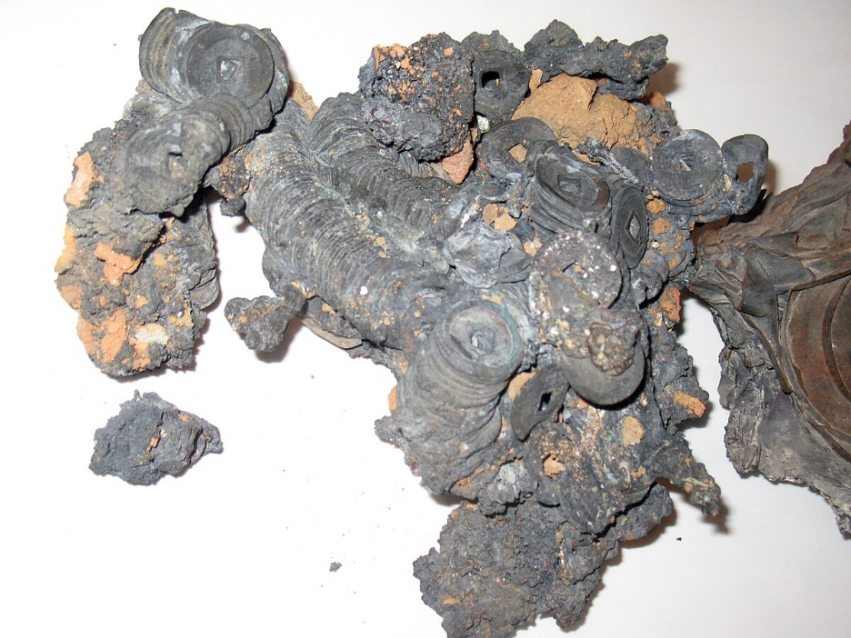
Atomic bombing of Japan: atmosphere explosions (“air bursts”)
Bombing of Nagasaki @ about 500 m height
Melted coins – Hiroshima. It happened to people too
Notes:
Coins: https://commons.wikimedia.org/wiki/File:Japanese_coins_melt_by_atomic_bombing_anagoria.JPG
Nagasaki: https://commons.wikimedia.org/wiki/File:Nagasakibomb.jpg

Slide 5
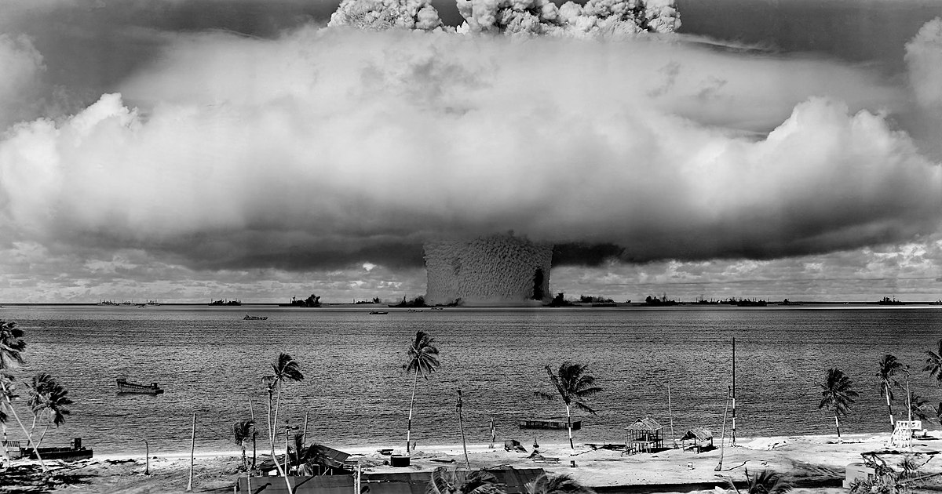
Operation Crossroads: Coming out party for the bomb. Test Baker, barge, shallow underwater – 26 July 1946
Notes:
Source Wikimedia Commons, at https://upload.wikimedia.org/wikipedia/commons/0/09/Operation_Crossroads_Baker_Edit.jpg
For radiological conditions at Operation Crossroads see Makhijani and Albright at http://ieer.org/wp/wp-content/uploads/1983/05/crossroads.pdf

Slide 6
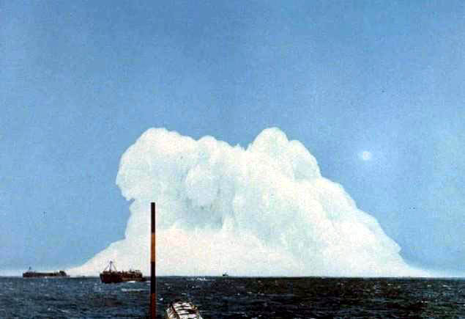
“Operation Wigwam”: Pacific Underwater – 29N and 126W. 610 meters depth. 30 kilotons – 14 May 1955: Unmanned target submarines were called “SQUAWS”
Round trip acoustic energy distance ~20,000 km
Notes:
Source: US government photo on Wikimedia commons at https://commons.wikimedia.org/wiki/File:Wigwam.jpg

Slide 7
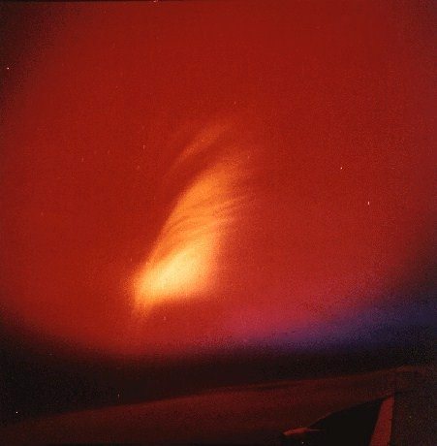
Starfish prime: 400 km altitude – 1.45 megatons. Electromagnetic pulse; disruption of radio communication
Notes:
Source: https://en.wikipedia.org/wiki/Starfish_Prime#/media/File:Operation_Dominic_Starfish-Prime_nuclear_test_from_plane.jpg

Slide 8
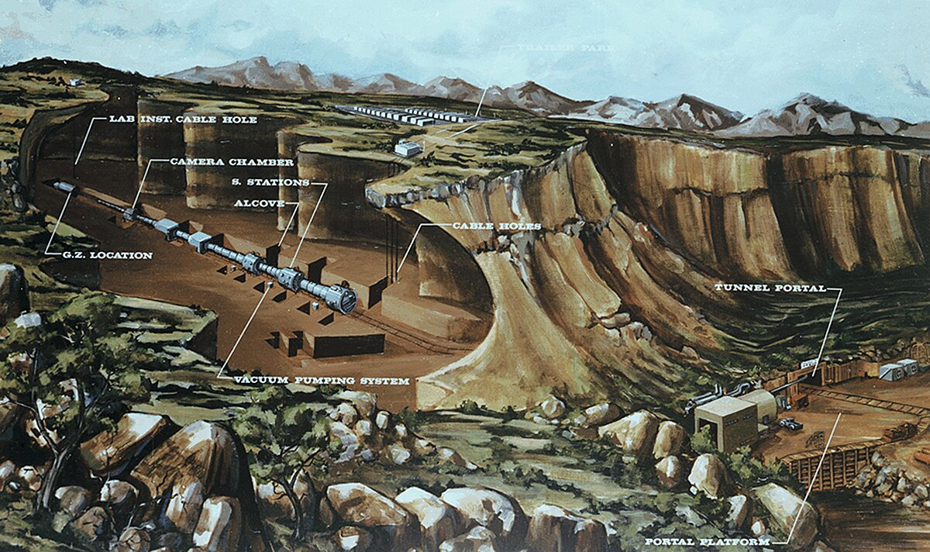
Underground test preparation
Notes:
Source: National Nuclear Security Administration – Wikimedia commons at https://commons.wikimedia.org/wiki/File:Layout_of_a_typical_horizontal_underground_nuclear_effects_test_in_Rainier_Mesa_001.jpg

Slide 9



Trinity test fallout survey sketch. Major recommendation: no similar test should be done within 150 miles of human habitation. High doses estimated on 16 July 1945 (red markings added)
Notes:
Source: Stafford L. Warren memorandum to Gen. Groves 21 July 1945 download at http://ieer.org/wp/wp-content/uploads/2003/07/14_staffordmemo_trinity_1945.pdf

Slide 10
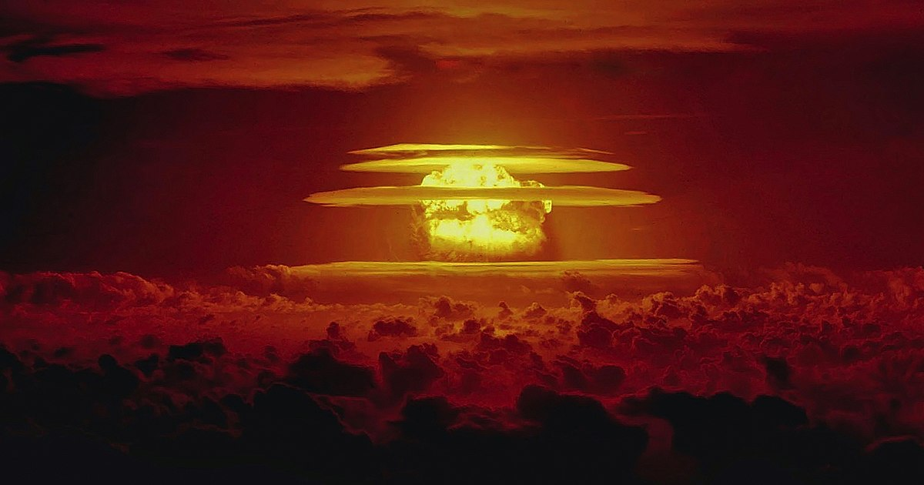
The BRAVO test, March 1, 1954
Notes:
Source: National Oceanic and Atmospheric Administration, from Wikimedia Commons at https://commons.wikimedia.org/wiki/File:Castle_Bravo_nuclear_test.jpg

Slide 11
Cumulative CASTLE Fallout, 1 July 1954
Notes:
Source: Robert J. List. World-wide Fallout from Operation CASTLE. Washington, D.C.: U.S. Department of Commerce, 17 May 1955 at https://www.osti.gov/servlets/purl/4279860-EGhXto/

Slide 12
Official estimates are often lower than independent ones. U.S. example for Marshall Islands testing – Utrik Atoll doses due to BRAVO test (15 Mt)
Type of Exposure | U.S. Dept. of Energy | Sanford Cohen & Assoc.
External whole-body (Gy) | 0.11 | 0.5+
Internal Thyroid (Sv)
Adult | 1.55 | 27
Child | 3.2 | 34
Infant | 6.6 | 59
Internal (Other than Thyroid) Sv Committed Effective Dose Eq.
Adult | 0.076 | 0.86
Child | 0.137 | 1.12
Infant | 0.317 | 1.93
Notes:
Source: Bernd Franke, Review of Radiation Exposures of Utrik Atoll Residents. Heidelberg, Germany: ifeu-Institut für Energie- und Umweltforschung, GmbH, prepared for Sanford Cohen & Associates, 2002

Slide 13
Children are most affected by radiation
6000
Cancer Incidence per 100,000 for a 0.1 Gy Dose
(All Cancers)
5000
Male Female
4000
3000
2000
1000
0
0
10
20
30 40
50
60
70
80
Age at Exposure (years)
Source: Arjun Makhijani, Brice Smith and Mike Thorne. Science for the Vulnerable: Setting Radiation and Multiple Exposure Environmental Health Standards to Protect Those Most at Risk. Takoma Park, MD: Institute for Energy and Environmental Research, October 19, 2006, at http://ieer.org/resource/press-releases/science-vulnerable-setting-radiation. Figure 6 (p. 38)
Notes:
Source: Arjun Makhijani, Brice Smith and Mike Thorne. Science for the Vulnerable: Setting Radiation and Multiple Exposure Environmental Health Standards to Protect Those Most at Risk. Takoma Park, MD: Institute for Energy and Environmental Research, October 19, 2006, at http://ieer.org/wp/wp-content/uploads/2006/10/Science-for-the-Vulnerable.pdf - Figure 6 (p. 38) based on National Academies BEIR VII report, 2006.

Slide 14
Some damage estimates: Atmospheric testing
Strontium-90 inventory: 250,000 TBq (decay corrected)
Cesium-137: 400,000 TBq (decay corrected)
Carbon-14: 400,000 TBq; minimal decay so far
Plutonium-239: 4,200 kilograms; minimal decay so far
Estimated cumulative radiation doses to global population to the year 2000: 5.44 million person-Sieverts
Corresponding global cancer incidence cumulative to the year 2100: about 600,000 (rounded). Risk is greatest in the 30ºN to 60ºN latitude band. (Are doses underestimated?)
Nevada testing: I-131 release: 5.6 million TBq (150 million curies). USA alone: 11,300 to 212,000 thyroid cancers (incidence)
Risk of thyroid cancer female infant is 70 times that of a 30 y male per unit of intake.
Difficult to extrapolate global health harm in detail from US assessments (which are the most detailed – including independent estimates).
Destruction of coral reefs;
Acoustic impact of underwater tests.
Ciguatera poisoning via fish.
Destruction of traditional livelihoods and disruption of traditional diets.

Slide 15
Impacted populations
Downwinders;
Indigenous people;
Colonized countries;
Hibakusha in Japan;
Atomic veterans;
Those who produced weapons and the entire chain of materials.
Essentially the entire global population;
Generations far into the future – especially those impacted by radioactive waste and severely damaged ecosystems.

Slide 16
US power versus major birth defects for babies worldwide – one 1960 perspective
University of California Engineering alumni magazine April 1960 editorial:
“The ultimate aim of the Soviet Union and China is the Communization of the entire world, by force of arms if necessary. Our defense, and thus the defense of the free world, is based on atomic and hydrogen weapons.”
“…your babies' chances of having a major birth defect [due to nuclear testing fallout] are increased by one part in 5,000 approximately. Percentagewise, this is insignificant.”
“…it means that nuclear testing so far has produced about an additional 6,000 babies born with major birth defects.”
“…you must weigh this acknowledged risk with the demonstrated need of the United States for a nuclear arsenal.”
Notes:
California Engineer April 1960 editorial reprinted in California Engineer, v.68, no.3, March 1990, p. 23.

Slide 17
Use: Facts and reflections
In the minds of almost all scientists, the bomb project was started to prevent a Nazi monopoly (exemplified by the famous 1939 Einstein letter).
Groves 23 April 1945 briefing paper: “The target is and was always expected to be Japan.” (Emphasis added). Germany was actually de-targeted on 5 May1943 – even as the Manhattan Project was getting into high gear.
Truman’s Secretary of State Jimmy Byrnes remarked to Szilard (May 1945) that if the bombs were not shown to have results for the money that was spent how would Congress appropriate money after the war?
Daniel Ellsberg wrote in the late1970s that nuclear threats were use of nuclear weapons – in the manner of a gun used during a holdup but not fired.
The use of the bombs on Japan had experimental aspects: measuring the impact of the bombs in different landscapes and cities.
Dan Ellsberg in Doomsday Machine: “Thus, virtually any threat of first use of a nuclear weapon is a terrorist threat.”
Only China and India have a declared “no first use policy”.
Notes:
Re: de-targeting of Germany and history of targeting Japan see Makhijani 2003 at https://ieer.org/resource/commentary/nuclear-targeting-the-first-60-years/

Slide 18
Radiation matters and disarmament
Awareness of harm from testing – scientists’ work (e.g. to measure strontium-90 in baby’s teeth) and advocacy played a major role in the 1963 Partial Test Ban Treaty.
Compensation demands, lawsuits against nuclear weapons contractors also raised profile of harm of nuclear weapons.
Growing awareness of harm from production, testing, and use
Treaty on the Prohibition of Nuclear Weapons has health and ecological harm and humanitarian concerns at its core.

Slide 19
Some resources
Eleven short papers - one each on major test sites is here. Each has a bibliography. Written in 2022.
IPPNW and IEER: Radioactive Heaven and Earth 1991.
Sebastian Phillipe et at. French testing in Polynesia reassessment 2021
Sebastian Phillipe et al. 2023 reassessment of the Trinity test and tests at NTS
Nuclear Weapons Archive.

Slide 20
QUESTIONS

